Slide 1
Microsoft Ignite
Notes:
FULL SCREEN
Holding screen – until 5 mins before

Slide 2
Delivering a multi-tenant Azure platform with a single deployment
Zachery Olinske
Matthew Greenham
Erhan Sanlioglu
Notes:
FULL SCREEN
Session slide – 5 minutes before
Until Go Live

Slide 3
Notes:
FULL CAMERA
WELCOME FROM ZACH

Slide 4

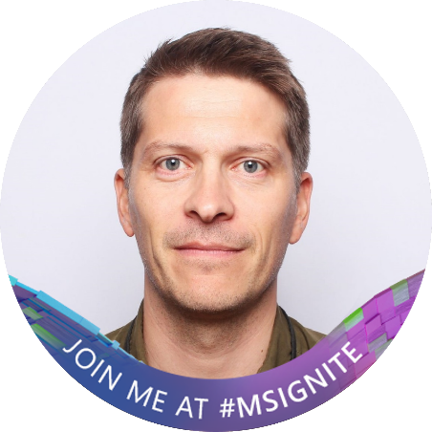

Speakers
Zachery Olinske
Cloud Solution Architect
Microsoft Norway
Matthew Greenham
Azure Team leader
SpareBank 1 Utvikling
Erhan Sanlioglu
Azure Platform Developer
SpareBank 1 Utvikling
Notes:
PICTURE IN PICTURE

Slide 5






Some of the brands in the SpareBank 1 Alliance
Notes:
PICTURE IN PICTURE
SpareBank 1 is a family of 13 independents banks with strong local connections across the whole of Norway.
Our shared brand is governed by SpareBank 1 Utvikling

Slide 6

SpareBank 1 is a family of 13 independents banks with strong local connections across the whole of Norway.
Our shared brand is governed by SpareBank 1 Utvikling
Notes:
PICTURE IN PICTURE

Slide 7


13 independent SpareBank 1 banks in Norway
Notes:
PICTURE IN PICTURE
MATT:
The SpareBank 1 alliance consists of 13 independent savings banks, who cooperate on branding and providing a joint platform.
SpareBank 1 is Norway’s second largest finance group in terms of assets.
The alliance was created in 1996 to strengthen each local bank’s competitiveness, profitability and solvency, as well as to ensure each bank’s future independence and regional ties.
Many of the regional banks have excisted for several hundred years individually.
There are 8900 employees in the SpareBank 1 alliance.
SpareBank 1 Utvikling supplies IT platforms and joint management and development services to alliance banks (e.g. our online banking and mobile apps), and helps to ensure that joint development and platyform management provide the banks with economies of scale and competitive advantages.

Slide 8

Notes:
FULL CAMERA
ZACH: This is not SpareBank 1 first rodeo-”attempt” using Azure. What made you relook and how did you revamp your cloud journey?
ZACH: DID YOU HAVE ANY REQUIREMENTS WHEN YOU STARTED

Slide 9





Azure Landing Zone
CAF & ALZ
Tenants and billing
IAM
Security
DevOps
Azure DevOps
Code repository
Project planning / kanban board
pipelines (CI/CD)
Management
Azure Bicep
Infrastructure as Code
Declarative Infrastructure
Networking
Governance
Cloud Adoption Framework
Resource
Organization
Multi-Tenant deployment
Notes:
PICTURE IN PICTURE

Slide 10
Notes:
FULL CAMERA
Zach: Let’s talk about the 13 Azure AD Tenants spread across the SpareBank 1 Alliance. Why?!

Slide 11
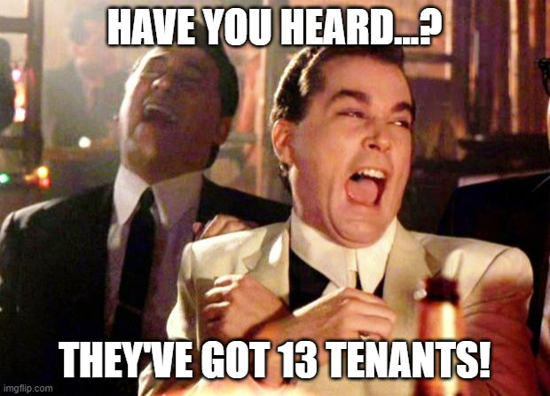
Notes:
PICTURE IN PICTURE

Slide 12
Notes:
FULL CAMERA
ZACH: Do the banks have the same desire to manage and create Azure platforms themselves?
ZACH What Azure infrastructure is shared between the banks?

Slide 13











Main network topology
SpokeTenant
SpokeTenant
SpokeTenant
Core Subscriptions
Landing Zones
Core Subscriptions
Landing Zones
Core Subscriptions
Landing Zones
Hub Tenant
Vwan Hub
Connectivity
Landing Zones
Internet
AzFirewall (Mgr)
On-Prem
Notes:
PICTURE IN PICTURE

Slide 14
Notes:
FULL CAMERA
ZACH How do you actually deploy across the Multiple Azure AD Tenants?

Slide 15

Core Pipelines
core-00-root
Landing Zone Pipelines
Responsible for creating core platform subscriptions
lz-00-subscriptions
core-01-management
Responsible for creating Landing Zones
Responsible for creating centralized resources for management subscription
lz-01-networking
core-02-policy
Responsible for creating ASG, NSG, vnet and
vwan connection for Landing Zones
Responsible for creating policy definitions, initatives and assignments
core-03-con-vwan
Responsible for creating vwan, hub, firewall, vpn s2s
core-04-con-fw-rules
Onboarding Pipelines
Responsible for creating IPGroups and firewall rules
core-05-networking
Eunomia-Onboarding
Responsible for creating ASG, NSG, vnet and vwan connection for core subscriptions
Responsible for creating repo, variable group, management group hierarchy, SP, PIM
core-06-dns
Responsible for creating the DNS servers
Notes:
PICTURE IN PICTURE

Slide 16

Onboarding Prerequisite
EA-Service Account
secondTenant
Enrollment account(Guest)
Sparebank1 tenant
Notes:
PICTURE IN PICTURE
First step: Authenticate to Microsoft Azure Powershell, azure portal and ea.portal.com(EA Administrator)
Should not be blocked by Conditional Access policies
Dont mention all of the roles, make a short point of it.
Second step: Application Developer, User Administrator, Guest Administrator, Privileged Role Administrator, Owner with root level scope an also allowing it to logon to Azure AD

Slide 17
Notes:
FULL KAMERA
Zach:

Slide 18
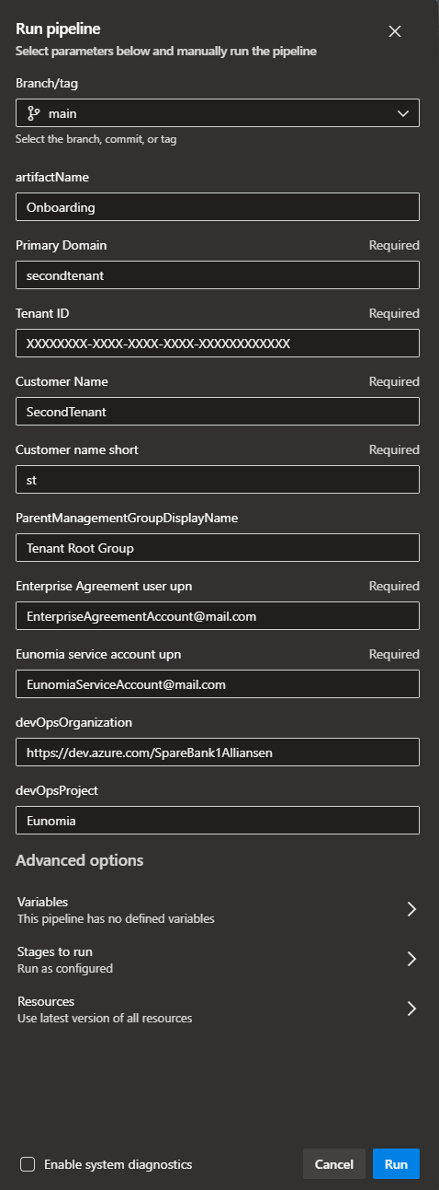







Onboarding a new tenant
Pipelines
eunomia-secondtenant
Eunomia-Onboarding
Tenant repo
networking.json
Variable group
base.json
Mgmt group
Service Principal
SecondTenant
Azure AD Groups
PIM Configuration
Eunomia
Core
LandingZones
Sandbox
Staging
Decom
Public
Private
Notes:
PICTURE IN PICTURE

Slide 19

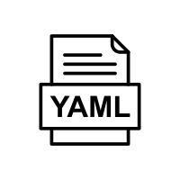
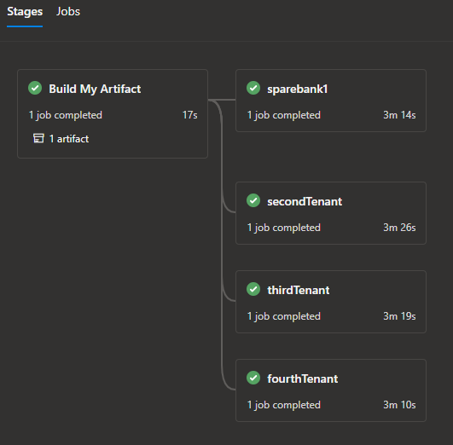
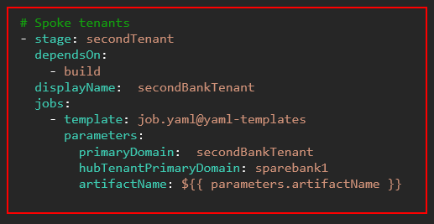
Multi-tenant deployment
Yaml-templates
prod-stage-tenants.yaml
parameters:
- name: artifactName
stages:
# HUB tenants
- stage: sparebank1
dependsOn: build
displayName: sparebank1
jobs:
- template: job.yaml@yaml-templates
parameters:
primaryDomain: sparebank1
hubTenantPrimaryDomain: sparebank1
artifactName: ${{ parameters.artifactName }}
core-00-root
core-01-management
core-02-policy
core-03-con-vwan
core-04-con-fw-rules
core-05-networking
core-06-dns
Lz-00-subscriptions
Lz-01-networking
Notes:
PICTURE IN PICTURE
Using yaml-templates to simplify deployment to multiple tenants.

Slide 20
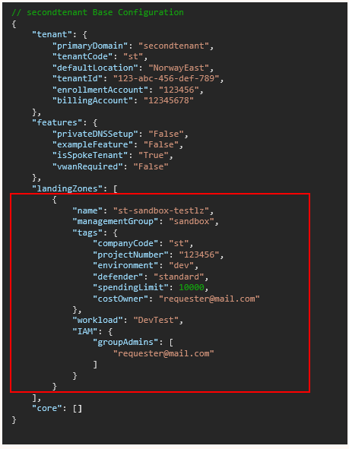






eunomia-secondTenant
base.json
networking.json
SecondTenant
// secondtenant Base Configuration
{
"tenant": {
"primaryDomain": "secondtenant",
"tenantCode": "st",
"defaultLocation": "NorwayEast",
"tenantId": "123-abc-456-def-789",
"enrollmentAccount": "123456",
"billingAccount": "12345678"
},
"features": {
"privateDNSSetup": "False",
"exampleFeature": "False",
"isSpokeTenant": "True",
"vwanRequired": "False"
},
"landingZones": [],
"core": []
}
lz-00-subscriptions
Subscription
Resource Providers
Eunomia
Defender
Activity Log Export
Tags
Core
LandingZones
Sandbox
Staging
Decom
Budget
Azure AD Groups
PIM Configuration
Public
Private
st-sandbox-testlz
Notes:
PICTURE IN PICTURE

Slide 21
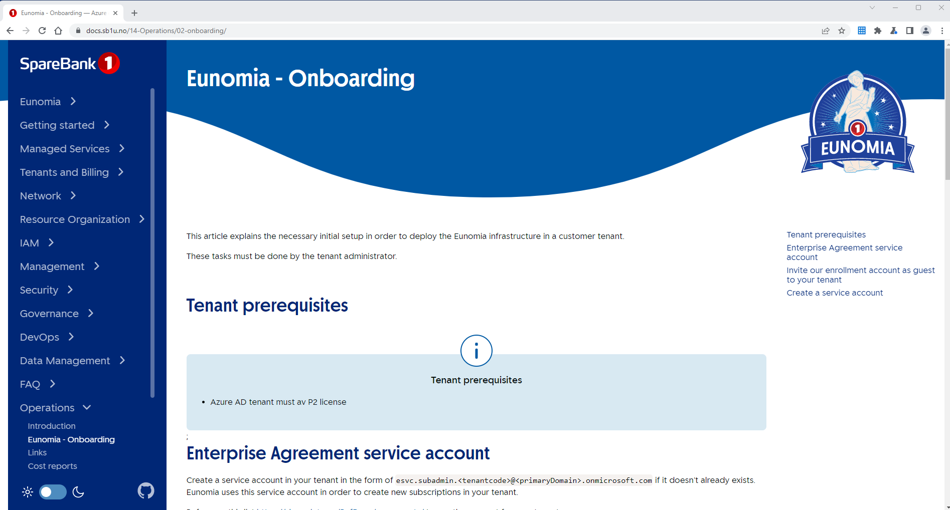
Eunomia - Docs
Notes:
PICTURE IN PICTURE

Slide 22
Notes:
FULL CAMERA
Zach:
How do the end-users request new Subscriptions?

Slide 23
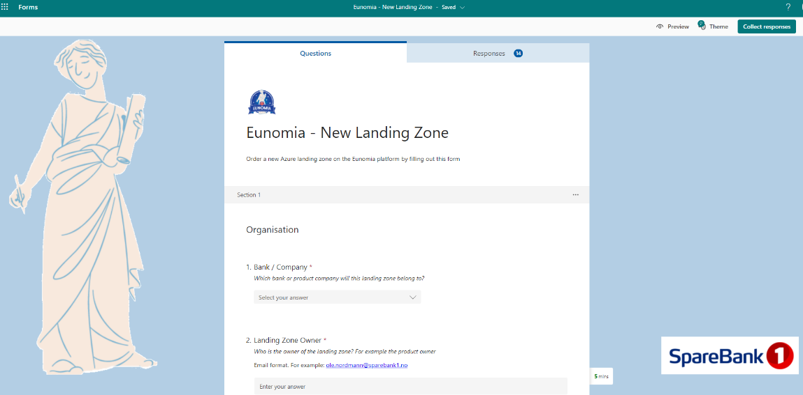
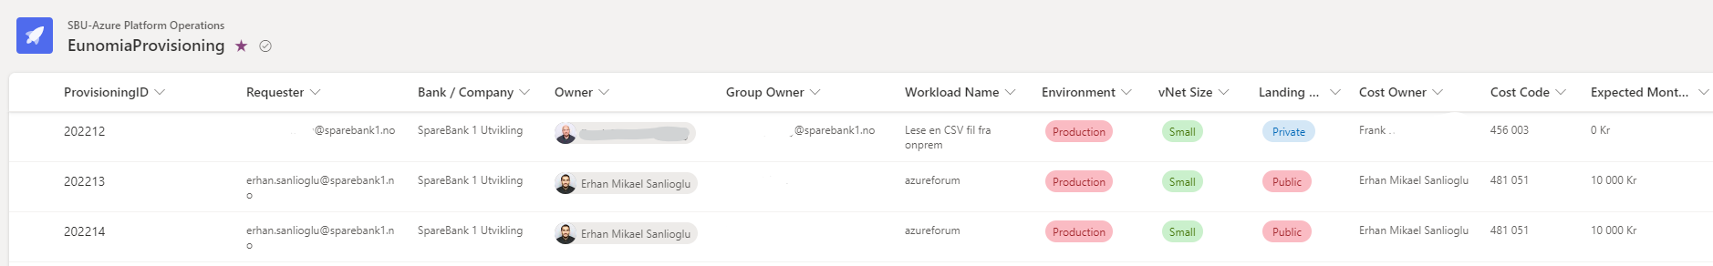
How do end users request new Subscriptions?
Different ordering process per tenant / company
MVP – Forms – SPO – JSON - Pipeline automation
Config file changes. Working on further improvements for automation

Slide 24
Notes:
FULL CAMERA
ZACH: WHAT WERE THE CHALLENGES?
During this revamped journey using Azure Landing Zone and streamline deployments across multiple Azure AD Tenants. I am sure you ran into some challenges opportunities. Can you showcase few of them?
What were the tehnical painpoints?

Slide 25

Challenges
Understanding ALZ
Management Group hierarchy
Organizing the team
Testing
Pipeline setup
Private Link (DNS)
Notes:
PICTURE IN PICTURE

Slide 26



DNS with PrivateLink
Spoke Tenant 1
Spoke Tenant 2
st1kv.privatelink.vaultcore.azure.net
st2kv.privatelink.vaultcore.azure.net
Hub Tenant
Vwan Hub
privatelink.vaultcore.azure.net
st1kv
AzFirewall (Mgr)
st2kv
On-Prem
Notes:
PICTURE IN PICTURE
Azure policy – Matt understand a little
Policy som ligges i Repo
Slette

Slide 27
Notes:
FULL CAMERA
FULL KAMERA
Zach:
FINAL LEARNINGS

Slide 28

Key learnings
Build iteratively
Fail fast
Think of your customers (internal dev platform)
Keep it simple!
Notes:
PICTURE IN PICTURE
If we ignore the operations and organizational things… separate topic (very important)…. Here is the list of learnings

Slide 29
Key learnings
Build iteratively
Fail fast
Think of your customers (internal dev platform)
Keep it simple standardised!
Notes:
PICTURE IN PICTURE
If we ignore the operations and organizational things… separate topic (very important)…. Here is the list of learnings

Slide 30
Notes:
FULL CAMERA
Zach:
THANKS. HOW CAN PEOPLE LEARN MORE?!

Slide 31



Learn more…
https://learn.microsoft.com/en-us/azure/cloud-adoption-framework/
https://github.com/Azure/ALZ-Bicep
https://www.linkedin.com/company/sparebank-1-utvikling
https://github.com/sparebank1utvikling/Ignite2022
https://www.kode24.no/artikkel/sann-lager-sparebank-1-sin-nye-skyplattform-tidlig-ute-med-bicep/77426381
Notes:
PICTURE IN PICTURE
Bye Bye!!!

Slide 32
Q & A
Notes:
FULL CAMERA
THE END

Slide 33
Microsoft Ignite
Notes:
FULL SCREEN
🎉🎉🎉🎉🎉

